Slide 1
QuickScan™ Lite QW2100
September 2013

Slide 2
QuickScan™ Lite QW2100
Entry level linear imager
Perfect for general purpose scanning requirements
Snappy performance for most scanning tasks

Slide 3
QuickScan™ Lite QW2100
Laser like linear imager
Sharp and thin illumination
Long scan line to read long bar codes at closer distance
Stylish design with reduced dimensions
Best size/weight/ performance ratio
Smaller and lighter than competing products: 119 g / 4.2 oz
Ergonomic and rugged look

Slide 4
QuickScan™ Lite QW2100
Two Interface Options
QW2120: USB only
QW2170: RS-232 / Keyboard Wedge
Kits and Bulk Packaging Available
Scanner / Cable
Scanner / Cable / Stand
10 Unit Pack

Slide 5
QuickScan™ Lite QW2100
Supported by Datalogic Aladdin™ Configuration Program
Datalogic’s patented ‘Green Spot’ technology for visual good-read confirmation
Ergonomic stand design
Collapsible
Adjustable scan angle
Holder or Wall Mount

Slide 6
Features and Benefits

Slide 7
Excellent Bar Code Reading
Superior reading on bad and hard-to-read labels
Wide Scan Angle: 60° +/- 3°
Ability to read long bar codes at closer distance
EAN13 - 13 mils: 0 to 45 cm / 0 to 18.0 in
Maximum code resolution
4 mils / 0.102 mm
Maximum performance in a value-priced reader

Slide 8
Datalogic’s Patented ‘Green Spot’
Green Spot for visual good-read feedback
The Green Spot is clearly seen on the bar code by the user, even in bright lighting conditions or noisy environments
Visual confirmation that the bar code was properly read

Slide 9
Designed for Quality
Sealing Rating: IP42
ESD Protection: 16 kV
1.5 m / 4.9 ft Drop Resistance
Tested to 1 Million trigger hits
3-Year Factory Warranty
Protects Technology Investment
Lowers the Total Cost of Ownership (TCO)

Slide 10
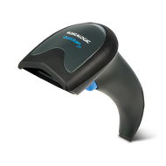
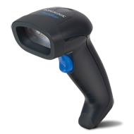
What’s the Same? QuickScan Lite vs. QuickScan I
Feature | QuickScan Lite QW2100 | QuickScan I QD2100
Datalogic ‘Green Spot’ Technology | YES! | YES!
Share the majority of cables and power supplies | YES! | YES!
Datalogic Aladdin Configuration Software | YES! | YES!
Share Most Programming Labels | YES! | YES!
Kits Available: Scanner Only, Scanner/Cable and Scanner/Cable/Stand | YES! | YES!

Slide 11
What’s Different? QuickScan Lite vs. QuickScan I
Feature | QuickScan Lite QW2100 | QuickScan I QD2100
Interfaces | USB Only RS-232/KBW | RS-232/IBM 46XX/USB RS-232 /USB/KBW/Wand
Colors Available | Black | Black, White
Input Power Sources | 5 VDC | 5 - 12.0 VDC
Scan Angle | 60° | 42°
Stand Option | Collapsible | Gooseneck
Overmold Enclosure | YES | NO
User Replaceable Scan Window | NO | YES
Bulk Packaging | 10 Unit Packs | NO

Slide 12
Target Markets and Applications

Slide 13
Retail Food / Non-Food
POS Check-out
Customer Service
Returns Management
Fashion, Clothing and Accessory Stores
Tobacco Shops, News Agents, Book Shops, Pharmacies
General Merchandise Stores
Building Materials, Hardware, Garden Supply
Gasoline Service Stations
Home Furniture and Equipment Stores

Slide 14
Retail Food / Non-Food
QuickScan Lite Winning Features
Instinctive reading / snappiness
Datalogic patented ‘Green Spot’ technology for visual good-read confirmation
Reading on poor and damaged labels
Able to read long bar codes
Ergonomic - Small dimension
Reliability - Good IP Sealing Rating and ESD Protection

Slide 15
Banks, Finance, Utilities, Government and Postal
Front Office
Office Automation
Document Handling
Document Verification
Document Traceability
Banking System
Insurance Agents
Utilities
Pharmacies
Post Offices

Slide 16
Banks, Finance, Utilities, Government and Postal
QuickScan Lite Winning Features
Excellent for reading long bar codes in utility bills
Reading snappiness
Datalogic patented ‘Green Spot’ technology for visual good-read confirmation
Superior reading on bad, damaged and hard-to-read labels

Slide 17
Models and Accessories

Slide 18
QuickScan™ Lite QW2100 Models
Part Number | Description
QW2120-BK | QuickScan Lite Imager, Black, USB Interface
QW2170-BK | QuickScan Lite Imager, Black, KBW/RS-232 Interface
QW2120-BK-10 | QuickScan Lite Imager, Black, USB Interface, 10 Unit Pack
QW2170-BK-10 | QuickScan Lite Imager ,Black, KBW/RS-232 Interface, 10 Unit Pack

Slide 19
QuickScan™ Lite QW2100 Cable Kits
Part Number | Descripton
QW2120-BKK1 | QuickScan Lite Imager, Black, USB Interface w/ Straight USB Cable (90A052044)
QW2120-BKK11 | QuickScan Lite Imager, Black, USB Interface w/ Coiled USB Cable (90A052043)
QW2120-BKK12 | QuickScan Lite Imager, Black, USB Interface w/ Enh Straight USB Cable (90A052065)
QW2120-BKK13 | QuickScan Lite Imager, Black, USB Interface w/ Enh Coiled USB Cable (90A052187)
QW2170-BKK3 | QuickScan Lite Imager, Black, KBW/RS-232 Interface w/ KBW Cable (90G001010)
QW2120-BKK1-10 | QuickScan Lite Imager, Black, USB Interface w/ USB Cable(90A052044), 10 Set Pack
QW2170-BKK3-10 | QuickScan Lite Imager, Black, KBW/RS-232 Interface w/ KBW Cable (90G001010), 10 Set Pack

Slide 20
QuickScan™ Lite QW2100 Stand Kits
Part Number | Description
QW2120-BKK1S | QuickScan Lite Imager, Black, USB Interface w/ USB Cable (90A052044) and Stand (STD-QW20-BK)
QW2120-BKK11S | QuickScan Lite Imager, Black, USB Interface w/ Coiled USB Cable (90A052043) and Stand (STD-QW20-BK)
QW2120-BKK12S | QuickScan Lite Imager, Black, USB Interface w/ Enh Straight USB Cable (90A052065) and Stand (STD-QW20-BK)
QW2170-BKK3S | QuickScan Lite Imager, Black, KBW/RS-232 Interface w/ KBW Cable (90G001010) and Stand (STD-QW20-BK)
QW2120-BKK1S-10 | QuickScan Lite Imager, Black, USB Interface w/ USB Cable (90A052044) and Stand (STD-QW20-BK), 10 Sets Pack
QW2170-BKK3S-10 | QuickScan Lite Imager ,Black, KBW/RS-232 Interface w/ KBW Cable (90G001010) and Stand (STD-QW20-BK), 10 Sets Pack

Slide 21
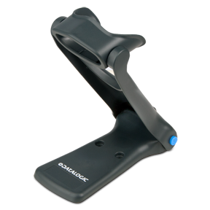
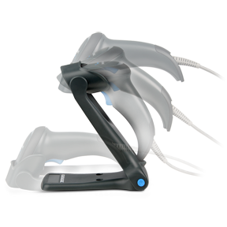
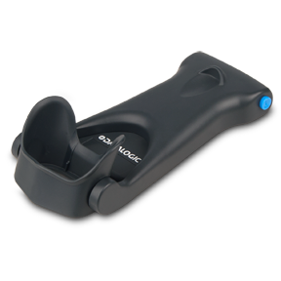
QuickScan™ Lite QW2100 Accessories
Part Number | Description
STD-QW20-BK | Black Collapsible Stand / Holder

Slide 22
Thank You!
Datalogic ADC, Inc.
959 Terry Street
Eugene, Oregon USA
Tel. +1 541 683-5700
Toll Free in the US: 1 800 695-5700
Fax +1 541 345-7140

