Slide 1
QuickScan™ QM2400 / QBT2400
August 2014

Slide 2
QuickScan 2400 Series: 2D Cordless
Value Proposition
Price Leader
Provide Customers an affordable migration solution to move from 1D Corded/Cordless to 2D Cordless
The Cable Replacement Concept
Innovative and differentiating product positioning
Winning Value
A multi-tasking product for front end and back store operations
POS checkout + in-store operations with a single device

Slide 3
Product Overview
Entry level cordless solution for customers looking to migrate from 1D corded/cordless to 2D cordless bar code reading
Datalogic’s STAR Lite 433 MHz radio and Bluetooth® Wireless Communications
New and unique features for cordless devices
Outstanding reading snappiness on virtually any code
New LED-based illumination and aiming system
Datalogic’s patented ‘Green Spot’ technology for visual good-read confirmation

Slide 4
Main Scanner Features
Reading features
Wide VGA: 752 x 480 pixels
60 frame/sec
25 IPS Motion tolerance
Physical Properties
Color: Black and Light Grey
Multi-interface: USB, KBW and RS-232
Environmental Specifications
1.5m/5.0 ft drop
IP42 Sealing Rating
Software Features
Supports Remote Management
Supports U.S. Driver License Parsing
Warranty: 3 Years

Slide 5
Main Cordless Features
Cordless Communications:
Datalogic’s STAR Lite 433 MHz Radio
Bluetooth® Wireless Communications
Radio Range
25 m / 82 ft Radio Range (open air)
Point-to-Point Only
Autonomy
Lithium-Ion, tool-free, user-replaceable battery
30,000 scans/charge
Less than 4 hrs recharge time
Scan-While-Charging capability
Distinctive Features
Recharge through USB / microUSB cable
Charging contacts replaced with battery (consumable accessory)

Slide 6
QuickScan QM2400 and QBT2400
Common Features
Automatic switching from handheld to hands-free reading
Scan-While-Charging
Automatic binding when reader is inserted into the base station
Automatic and manual Batch Mode (500 storable linear codes)
QuickScan QBT2400
Bluetooth v3.0 - Class 2
Compatible with Android™ and iOS devices through Bluetooth HID profile
QuickScan QM2400
Datalogic STAR Lite 433 MHz
No interference with Wi-Fi
Low sensitivity to obstacles

Slide 7
Illumination and Aiming System
Developed to reduce the visual stress of the operator during daily scanning activities
Soft dark red illumination combined with 2 blue LED triangles which point at the targeted bar code
New illumination and aiming system improves visual contrast for easier aiming
Produces very low eye fatigue for the best operator efficiency

Slide 8
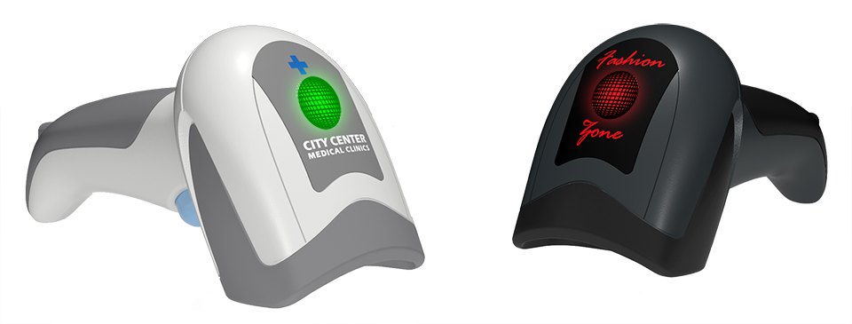
Brand Customization
Enhance your brand with customizable top cover insert
Combine with the desired light effect for more impact

Slide 9
QuickScan™ & Gryphon™ Series

Slide 10
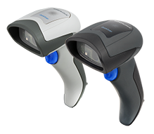
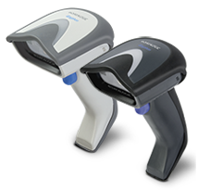
QuickScan 2D & Gryphon 2D Main Differences
Feature | QuickScan 2D | Gryphon 2D
Reading Performance | Instinctive Reading | Long Reading
Environmental Characteristics | 1.5 m / 5 ft drop, IP42 | 1.8 m / 6 ft drop, IP52
Available Models | SR | SR, HD, HC, Integrated Stand
Aiming System | CCD; 2 Blue Triangles | Laser; Cross + 4 Dots
Image Capture Capability | No | Yes
Distinctive Features | Green Spot | Motionix™/Green Spot
Key Selling Factor | Price | Performance
Retail Target Market Segment | Small/Medium Stores | Supermarkets
Value Proposition | Medium Throughput | High Throughput

Slide 11
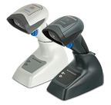
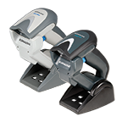
QuickScan & Gryphon Cordless Main Differences
Feature | QuickScan 2400 | Gryphon 4400
Available Radio Technologies | STAR 433 and Bluetooth 3.0 | STAR 433, 910 and Bluetooth 3.0
Reading Performance | Instinctive Reading | Long Reading
Environmental Characteristics | 5’ Drop / IP42 | 6’ Drop / IP52
Battery Life (Li-Ion) | 30K Scans/Charge | 60K Scans/Charge
Batch Mode Capability | 500 Codes | 1200 Codes
Cradle Mounting Options | Single Position | 2 Position/Wall Mount
Connectivity | Point to Point | Point to Multi-Point
Key Selling Factor | Price | Performance
Target Markets | Retail, Commercial Services | Retail, Entertainment, Light Mfg.
Retail Target Market Segment | Small/Medium Stores | Supermarkets
Value Proposition | Cable Replacement | Cordless System

Slide 12
Target Markets and Applications

Slide 13
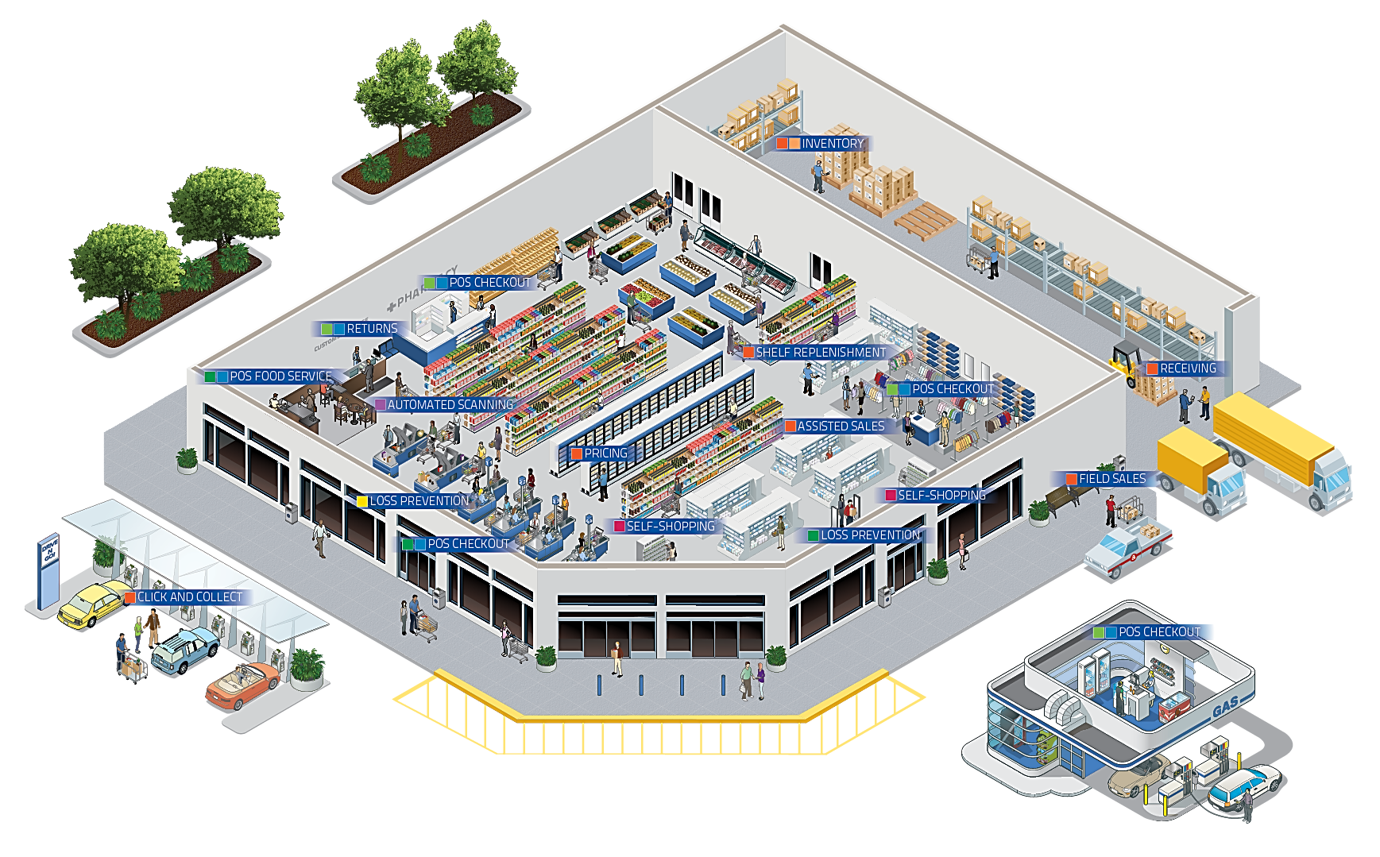
QuickScan 2D Cordless Absolute Versatility

Slide 14
Retail – In Store
Affordable pricing for migration from 1D corded/cordless to 2D cordless bar code reading
Reads electronic coupons on mobile phones or other reflective devices
Multi-tasking device for different in-store data capture needs:
POS Checkout
Inventory, price checking, shelf replenishment
Remote Management for asset management, remote configuration and software updates

Slide 15
Access Control for Transportation and Entertainment
Ticketing applications for hotels, restaurants and similar indoor environments
Excellent performance in reading electronic tickets via mobile phones
Extended autonomy and radio range with wide memory for batch mode
Datalogic’s patented ‘Green Spot’ technology for visual good-read feedback in noisy as well as quiet environments

Slide 16
Models and Accessories

Slide 17
QBT2400/QM2400 Models & Kits
Part Number | Description
QM2430-BK-433 | QUICKSCAN QM2430, SCR+BASE 433 BLK
QM2430-WH-433 | QUICKSCAN QM2430, SCR+BASE 433 WHT
QM2430-BK-433K1 | QUICKSCAN QM2430, 2D USB KIT 433 BLK
QM2430-BK-433K2 | QUICKSCAN QM2430, 2D RS-232 KIT 433 BLK
QBT2430-BK | QUICKSCAN QBT2430, SCR+BASE BT BLK
QBT2430-WH | QUICKSCAN QBT2430, SCR+BASE BT WHT
QBT2430-BK-BTK1 | QUICKSCAN QBT2430, 2D USB KIT BT BLK
QBT2430-BK-BTK2 | QUICKSCAN QBT2430, 2D RS-232 KIT BT BLK
QBT2400-BK-BTK+ | QUICKSCAN QBT2400, SCR ONLY + MICRO USB BLK
QBT2400-WH-BTK+ | QUICKSCAN QBT2400, SCR ONLY + MICRO USB WHT

Slide 18
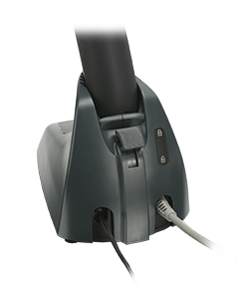
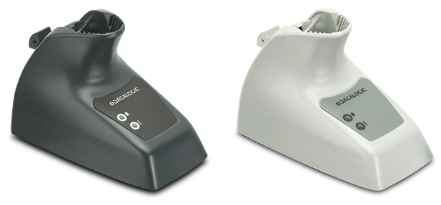
QBT2400/QM2400 Accessories
Part Number | Description
BC2030-BK-BT | BC2030-BASE/CHARGER M INT, BLK, BT
BC2030-WH-BT | BC2030-BASE/CHARGER M INT, WHT, BT
BC2030-BK-433 | BC2030-BASE/CHARGER M INT, BLK, 433
BC2030-WH-433 | BC2030-BASE/CHARGER M INT, WHT, 433
RBP-QMBT2X-BK | RBP-2X00 REMOVABLE BATTERY PACK BLACK
RBP-QMBT2X-WH | RBP-2X00 REMOVABLE BATTERY PACK WHITE

Slide 19
EASEOFCARE Support Programs

Slide 20
EASEOFCARE Support Programs
EASEOFCARE OVERNIGHT COMPREHENSIVE
Normal Wear, Tear and Accidental Damage
3 to 5 Year Programs
Advance Replacement
EASEOFCARE 2-DAY COMPREHENSIVE
Normal Wear, Tear and Accidental Damage
3 to 5 Year Programs
2-Business Day Turnaround with Express Shipment
SERVICE LEVEL
EASEOFCARE 5-DAY
Normal Wear and Tear
3 to 5 Year Programs
5-Business Day Turnaround
Factory Warranty
Factory Defects
1 to 5 Year Coverage
10-Business Day Turnaround
DURATION

Slide 21
Thank You!
Datalogic ADC, Inc.
959 Terry Street
Eugene, Oregon USA
Tel. +1 541 683-5700
Toll Free in the US: 1 800 695-5700
Fax +1 541 345-7140

